Slide 1
Lecture 22: Frequency Response Analysis (Pt II)
Conclusion of Bode plot construction
Relative stability
System identification example

Slide 2
Example
Sketch Bode diagram for

Slide 3
Example (continued)
M(dB)
φ(deg)
M(dB)
φ(deg)

Slide 4
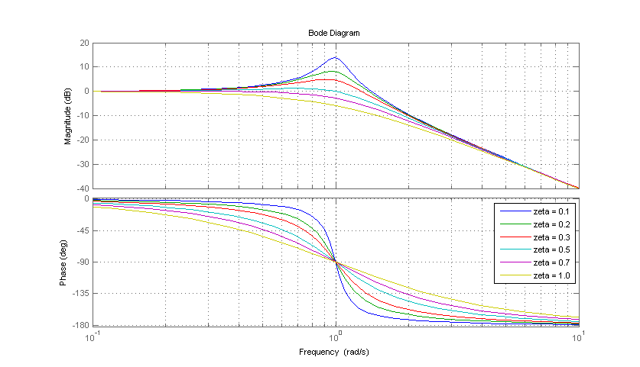
Complex conjugate poles (ζ<1)
Complex conjugate zeros have similar shape, just reflected over the horizontal axis

Slide 5
Relative Stability
Closed-loop poles in the LHP indicate stability
The closeness of the poles to the RHP indicate how near to instability the system is, robustness
Im
X
Re
X

Slide 6
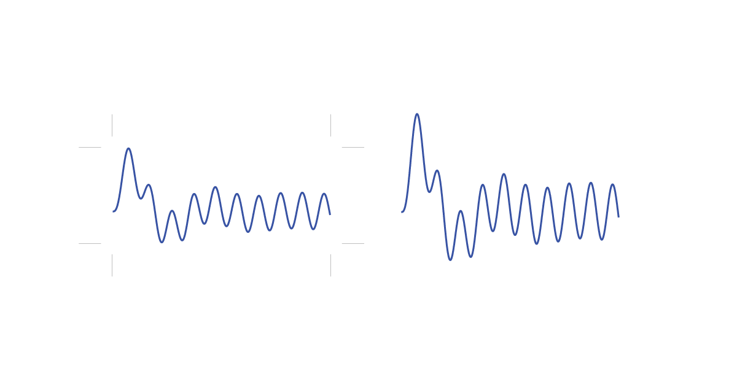
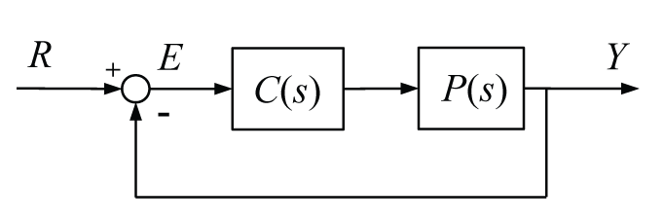
Relative Stability
Stability of a closed-loop system can also be determined from the open-loop frequency response
At 180º of phase lag of the loop, the reference and feedback signal add, if the magnitude of the loop is greater than 1 the error grows exponentially (unstable)

Slide 7
Relative Stability
Relative stability is indicated by how close the open-loop frequency response is to the point of 180º of phase lag and a magnitude of 1
More specifically,
Gain Margin (G_{m}) is the distance from a magnitude of 1 (0 dB) at the frequency where φ=-180º (phase crossover frequency)
Phase Margin (φ_{m}) is the distance from a phase of -180º at the frequency where M = 0 dB (gain crossover frequency)

Slide 8
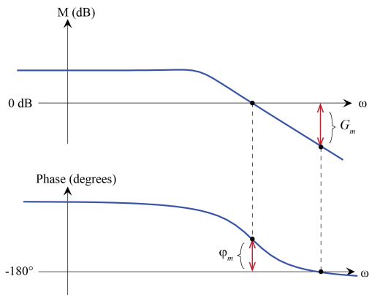
Relative Stability
In order to be stable, both gain and phase margin must be positive

Slide 9
Relative Stability
More intuitively,
Gain margin indicates how much you can increase the loop gain K before the system goes unstable
Phase margin indicates the amount of phase lag (time delay) you can add before the system goes unstable

Slide 10
Example
Determine the stability margins of the closed-loop system with the following open-loop frequency response

Slide 11
System Identification
Frequency response techniques can be useful for black-box modeling
Sweep sinusoidal input through a range of frequencies, measure scaling and phase shift of output
Identifies higher-order dynamics and zeros
One example is modeling of power converters

Slide 12
Example
Determine the magnitude and phase of a system that has the following steady-state output to the given input

Slide 13
Example
Estimate the transfer function for the system with the following frequency response

Slide 14
MATLAB Tools

